Slide 1
September 2018
IP Camera Signal Transmission
XCU Concept, XCU UXF, including DirectIP and DirectIP⁺
Changing the landscape for LIVE remote productions

Slide 2
Agenda
Why going to IP
IP Fundamentals
XCU - Camera base station with cradle solution
XCU UXF - Next generation camera base station
Why looking for remote productions
DirectIP - Camera signal transmission over IP
DirectIP⁺ - Remote production over IP networks

Slide 3
Why going to IP

Slide 4

Why going to IP – It’s a time of multiple changes
…from HD to 4K to 8K
…from SDR to HDR
…from a single to multiple distribution channels
…and many other things to come

Slide 5

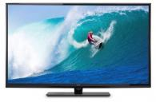


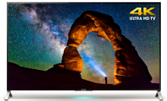
Why going to IP – The acceleration of format changes
Creating challenges with facility costs, speed of deployment & training
1934
2002
2020
Black & white
Color
HD
4K
8K
1972
2016
38 Years
30 Years
14 Years
4 Years

Slide 6


Why going to IP - What can IP do for you?
 | Video, audio, metadata, intercom
 | Multiple signals per cable
 | Bi-directional signals
 | Format & frame rate agnostic
 | New workflow models
 | Fast service launches
 | Easier, linear scaling (non-blocking)
 | Dynamic infrastructure ease of upgrades

Slide 7
Why going to IP – Summary for live applications
IP…
…add flexibility
…enables improved workflows
…support dynamic infrastructures
…delivers fully future proof solutions
IP help to better cope with the challenges in live broadcast applications
Notes:
But what if you could leverage the strengths of data centers …

Slide 8
IP - Fundamentals

Slide 9
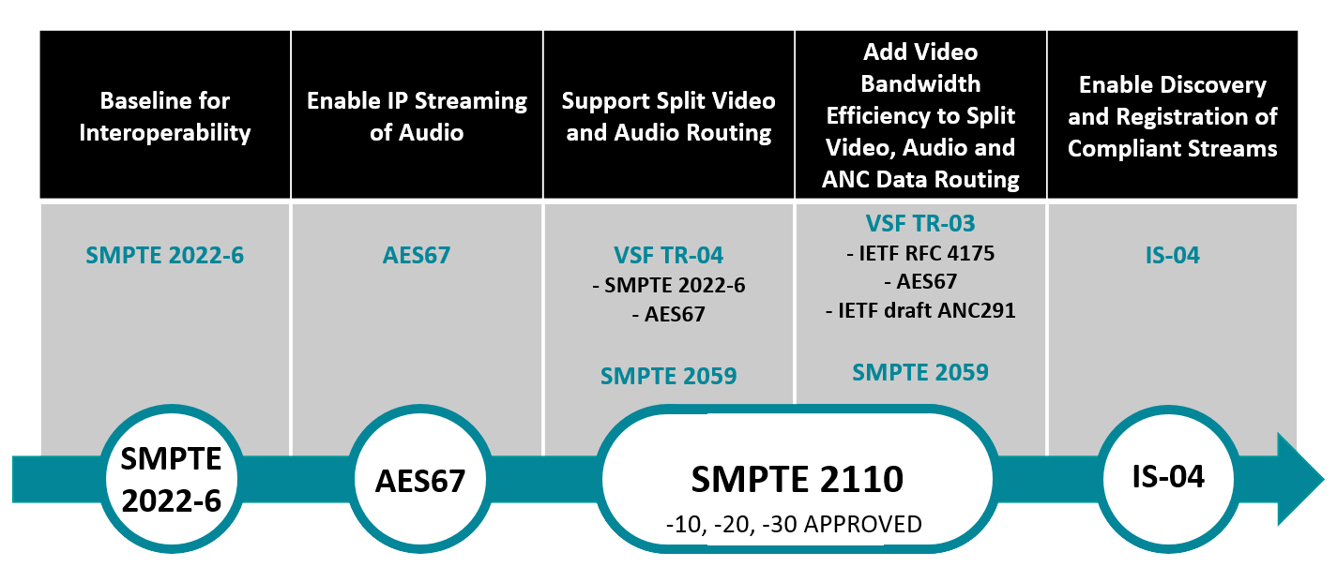
IP - Fundamentals – AIMS roadmap

Slide 10
IP - Fundamentals – SMPTE 2022-6 signal structure
SMPTE 2022-6 is like converting “SDI into the IP world”
All “info” available in the SDI stream about video, audio, etc.
ANC Data
Audio & I-Com
Video
SDI - World
SDI Stream
IP & 2022-6 Header
IP - World
SMPTE 2022-6 Stream

Slide 11
IP - Fundamentals – SMPTE 2022-6 signal flow
SMPTE 2022-6 carry all the different signals into one IP stream
  All signals are always in sync
    Therefore an optimized solution e.g. interconnecting two sites (or to transmit signals between camera head and XCU)
  Any processing require to “un-pack” and “re-pack” the IP stream

Slide 12
IP - Fundamentals – SMPTE 2110 signal structure
SMPTE 2110 for more efficient use of IP signal structure
All “info” available in the stream about video, audio, etc.
SMPTE 2022-6
SMPTE 2022-6 Stream
SMPTE 2110 Streams
-20
Video / RFC 4175
SMPTE 2110
-30
Audio / RFC 3190
SMPTE 2110 compared to SMPTE 2022-6
has reduced bandwidth by only
transmitting active part of video,
e.g. blanking is not transmitted
IP header
-30
I-Com / RFC 3190
Video
Audio
-40
ANC Data
ANC data
SDP-file
Description about video, audio, etc. necessary for the “receivers” to understand the content of the IP-packages
(Static configuration Info)
SDP
Session Description Protocol

Slide 13


IP - Fundamentals – SMPTE 2110 / Why SDP File?
Info required for receivers to “understand” the content of IP packages
  Without the SDP file the receiver don’t know which essences belong together
2110 -20
2110 -30
2110 -40
IP-link
?
IP source
IP destination
2110 -20
2110 -30
2110 -40
SDP
IP-link
+
Automatic set-up via SDP
Generated by IP source

Slide 14
IP - Fundamentals – SMPTE 2110 signal flow
SMPTE 2110 carry the different signals as separate essence in IP
  All signals are available as separate essences making the individual use of any signal easier and more efficient it is optimized for in-house workflows
  Optimized bandwidth efficiency by only carry required data's

Slide 15
XCU - Camera base station with cradle solution

Slide 16
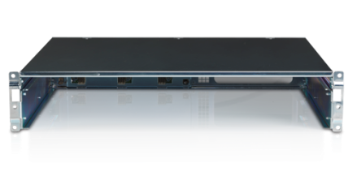
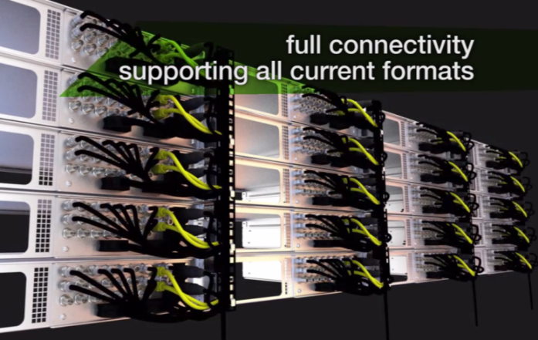
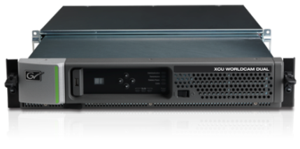
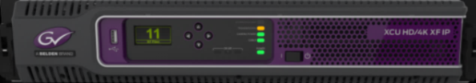
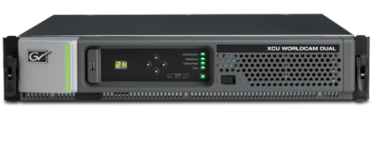
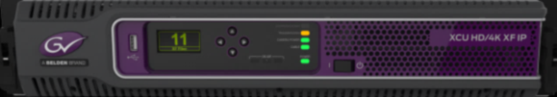
XCU - Camera base station with unique cradle solution
Additional camera base stations can be installed in seconds
  Support all LDX Series camera in all operational modes
  Memory in the cradle will automatically load the settings from the environment

Slide 17
XCU – What the unique cradle solution can do for you
The cradle…
…add flexibility
…enables improved workflows
…support dynamic infrastructures
…delivers fully future proof solutions
The cradle help to better cope with the challenges in live broadcast applications
Notes:
But what if you could leverage the strengths of data centers …

Slide 18
XCU UXF - Next generation camera base station

Slide 19
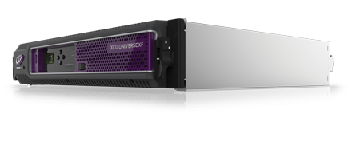
XCU UXF - And advanced UXF Cradle
Delivers an essential step towards a full IP live production solution
  Full Hybrid XCU with ALL signals available in baseband and IP creating maximum production flexibility
    Support of AIMS roadmap with full ST2110-10/20/30 and redundancy
    Support SMPTE 2022-6
  Support all production formats in IP as well as in base band
    Uncompressed 4K single speed or 4K TICO
    HD/3G with up to 6x speed
    Simultaneous SDR and HDR operation
    Wide color gamut

Slide 20
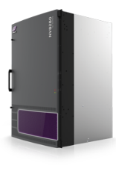
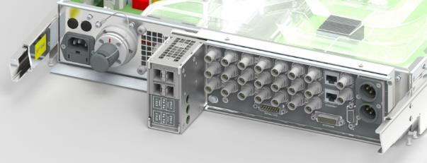

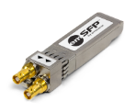



XCU UXF - And advanced UXF Cradle
New cradle with additional 4x MSA compliant SFP+ slots
  Adding network redundancy
  Can be equipped with 10 Gb/s Fiber SFP’s or with 12G SDI SFP
    12G SDI with single BNC or dual HD-BNC
12G SDI
2x 10Gb/s
2x 10Gb/s
Main IP Network
Redundant IP Network

Slide 21
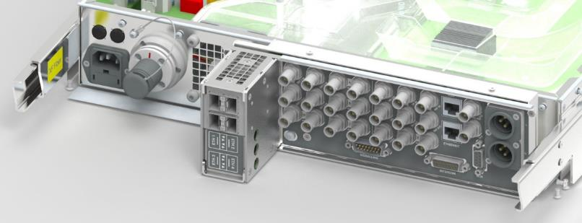
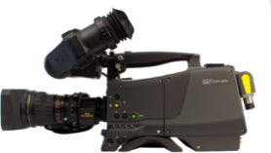
XCU UXF - ALL signals available in baseband and IP
UXF Cradle
XF Fiber
4x 10Gb/s IP Connections
2x main + 2x redundant
Supporting 2022-6 and SMPTE 2110
Supporting 4K, 3G, HD, HDR, returns, monitoring, reference (PTP), prompter
Supporting Audio (AES67)
Supporting I-Com (AES67)
Baseband Connections
Supporting 4K, 3G, HD, HDR, returns, monitoring, reference, prompter
Supporting Audio (Analog / SDI / AES/EBU)
Supporting I-Com (2-wire / 4-wire)
Supporting Tally
Supporting Camera Control (C2IP)
Supporting GPIO / data

Slide 22
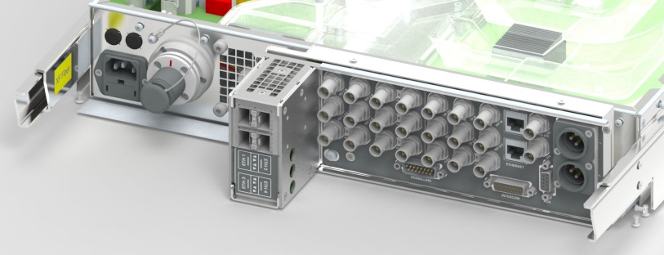
XCU UXF - Most seamless transition from base band to IP
  Different steps available during evolution to IP
  Advantage: Low risk, keep using proven infrastructure
  SDI for main signals and back-up
  SDI is still used for main and back-up as “test” with IP in parallel (no risk)
  When confident with IP, change-over to IP for main and SDI as back-up
  Make use of full IP advantage also for redundant IP path
  Everyone can migrate from base band to IP at their own speed!
A
B
C
D
Main
Back-up / Redundant
SDI
SDI
SDI
SDI
IP (test)
IP
SDI back-up
IP
IP
Redundant
IP SDI / Baseband
Time
A
B
C
D

Slide 23

XCU UXF – IP Media streams: SMPTE 2022-6
Main Video : HD / 3G / 4K-Tico
10Gb Ethernet
IP streams can be switched on/off
Main
2022-6
10Gb/s Ethernet
Audio (1+2+3+4) embedded
I-Com (prod + eng) embedded
Monitoring Video : HD
Monitor
2022-6
Audio (1+2+3+4) embedded
I-Com (prod + eng) embedded
Multicast (+ IGMP)
Unicast
PTP (2059 ; Slave)
4K main in 3G
Main 3G
2022-6
Audio (1+2+3+4) embedded
I-Com (prod + eng) embedded
Audio (1+2+3+4 ; 2110-30 ; L24)
Audio / I-comm
I-Com (prod + eng ; 2110-30 ; L24)
IP Network 10Gb/s
10Gb/s Ethernet
Audio (1+2 ; 2110-30 ; L24)
Audio / I-comm
I-Com (prog + prod + eng (+2nd prog) ; 2110-30 ; L24)
Ext 1
Ext 1 2022-6
Multicast (+ IGMP)
Unicast
PTP (2059 ; Slave)
I-Com (prog + prod + eng) de-embedded
Ext 2
Ext 2
2022-6
TP
TP
2022-6

Slide 24
XCU UXF – IP Media streams: SMPTE 2110
IP streams can be switched on/off
10Gb/s Ethernet
Main Video : HD / 3G / 4K-Tico
RFC LIVE
Monitoring Video : HD
RFC Mon
Multicast (+ IGMP)
Unicast
PTP (2059 ; Slave)
4K main in 3G
RFC HD
Audio (1+2+3+4 ; 2110-30 ; L24)
Audio / I-comm
I-Com (prod + eng ; 2110-30 ; L24)
SDP
IP Network 10Gb/s
10Gb/s Ethernet
Ext 1
Ext 1
Ext 2
Ext 2
Multicast (+ IGMP)
Unicast
PTP (2059 ; Slave)
TP
Ext 3 / TP
Audio (1+2 ; 2110-30 ; L24)
Audio / I-comm
I-Com (prog + prod + eng (+2nd prog) ; 2110-30 ; L24)

Slide 25
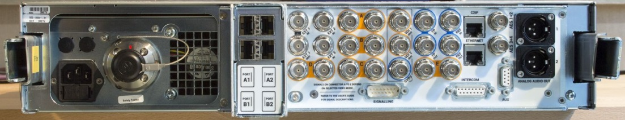






XCU UXF – Overview of all IP connections
IP trunk
10/100/1G
Camera Control
network
( C2IP )
XF transmission
10G IP
(Hybrid Fiber cable)
MAIN
IP network
10G IP
REDUNDANT
IP network
10G IP
IP switch
10/100/1G
MCP450
OCP
Camera
IP trunk
10/100/1G
e.g. VSM Control
(XML command protocol )

Slide 26
XCU – What the XCU UXF can do for you
The XCU UXF…
…add flexibility
…enables improved workflows
…support dynamic infrastructures
…delivers fully future proof solutions
The XCU UXF help to better cope with the challenges in live broadcast applications
Notes:
But what if you could leverage the strengths of data centers …

Slide 27
Why looking for remote productions

Slide 28
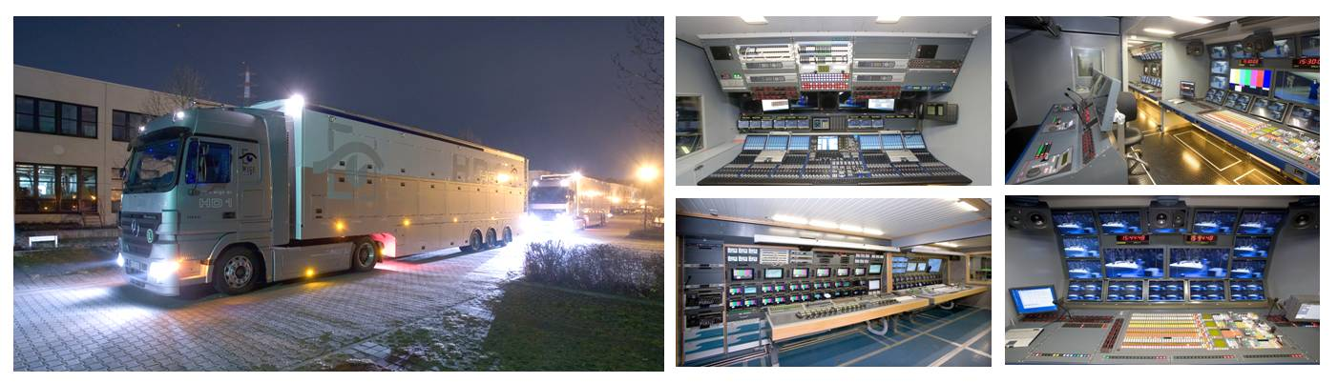
Why looking for remote productions
At typical OB-van productions…
…much (expensive) equipment is „on the road“ for most of the time.
…and a lot of operational people need to travel too.

Slide 29
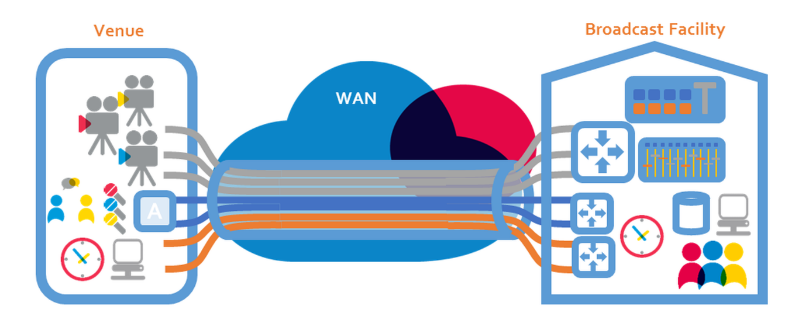
Why remote production – Better efficiency

Slide 30
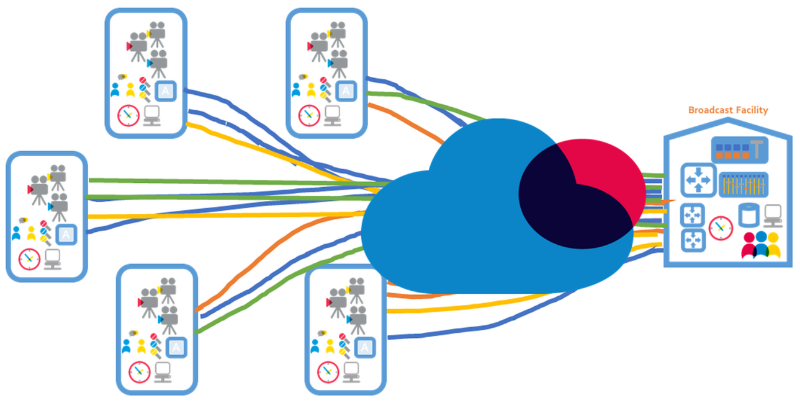
Why remote production – Better efficiency

Slide 31







Remote Production - Possible workflows
Traditional remote productions
+ Full flexibility
+ Adjustable bandwidth requirements
- IP gateway or dedicated network
multiplexing equipment required
- Difficult to set-up and maintain

Slide 32
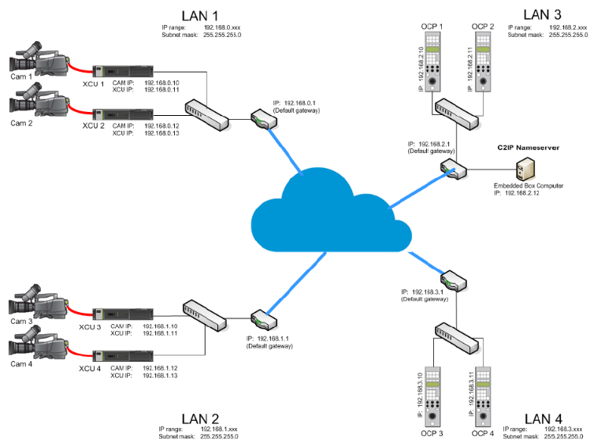
C2IP – IP based Camera Control Solution
The first camera control system fully based on open IP standards
  10/100BASE-T Ethernet / TCP/IP
  Layer 2
    For typical operation
  Layer 3
    For remote applications
    Managed by C2IP name server
    as option for the MCP 450
  LDX Connect gateway
    Embedded in the MCP 450
    Delivering an interface to
    third party control solutions
    via XML commands
    SDK available on request

Slide 33
DirectIP - Camera signal transmission over IP

Slide 34
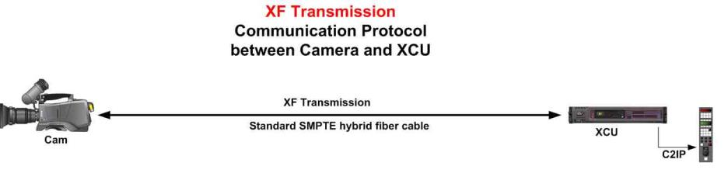
DirectIP - XF Transmission 10Gb IP based
Fiber A
Fiber B
SMPTE Hybrid Fiber cable
incl. 2x single mode fiber
Main Video
2022 5+6
Return
2022 5+6
Main ; 1 Channel SMPTE 2022-5+6
1080i50/59 = 1,8Gb
1080p50/59 = 3,4Gb
Return ; 1 Channel SMPTE 2022-5+6
1080i50/59 = 1,8Gb
1080i50/59 = 1,8Gb
C2IP + Private Data + I-com +
Analog Audio + Digital Audio =
~ 8Mb
IP Trunk =
0Mb (when not connected)
10Gb IP
10Gb IP
Analog Audio Stereo 24bits
Fiber A
Fiber B
Digital Audio Stereo 24bits
I-com Prog. Audio 16bits
I-com Prod. Audio 16bits
I-com Prod. Audio 16bits
I-com Eng. Audio 16bits
I-com Eng. Audio 16bits
C2IP
C2IP
Private Data
Private Data
IP Trunk
10/100/1G
IP Trunk
10/100/1G

Slide 35
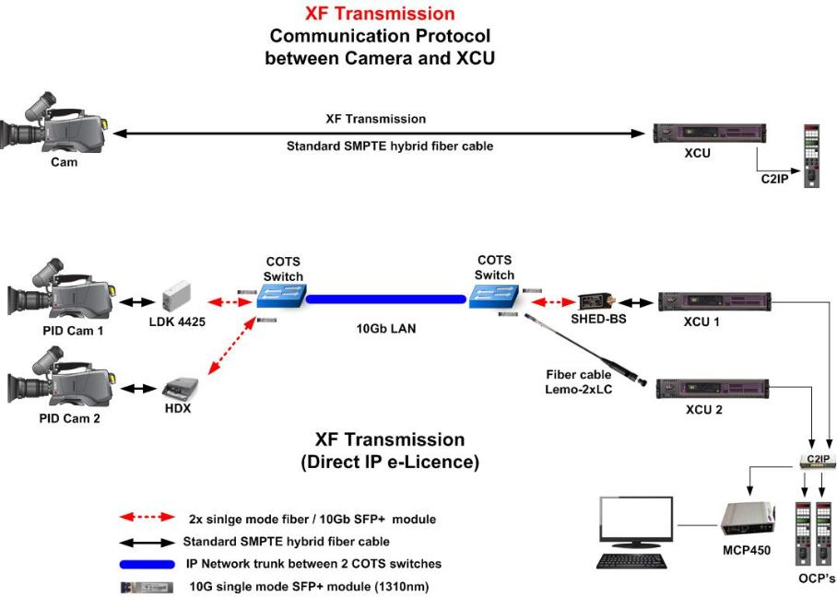
DirectIP - XF Transmission over 10G IP network

Slide 36
Remote Production - Possible workflows
2. DirectIP
+ Highest performance
+ Max. flexibility / utilization of equipment
+ Only COTS hardware required
+ Easy to set-up and maintain
- High performance IP network required
- Typically limited to campus installations

Slide 37
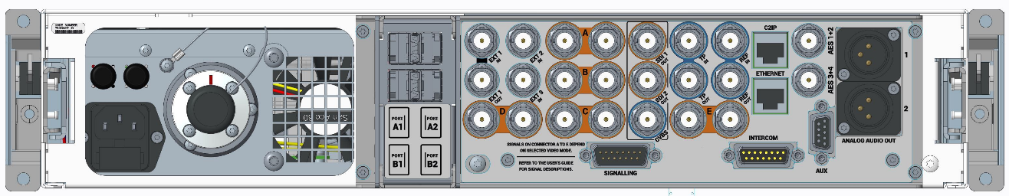


DirectIP - Why the XCU is required still (today)…
…the XCU generate all the base band signals
…the XCU deliver redundancy
…the XCU does some conversions / processing of UHD / HD
…the XCU provide the AnyLightXtreme flicker reduction
SMPTE hybrid Fiber connection for camera including power
4x SFP+ ports for extended IP connectivity
scalable from “just” video to a full IP production
All the traditional baseband connectivity from regular XCU’s while transitioning to IP

Slide 38






DirectIP – Use case “Cloud” production at NEP-NL
NEP “owns” the fiber network
Redundancy in the network (Spine-Leaf)
VSM Control for secure switching between studio’s
Separate VLAN for all cameras
Production site 1
Centralized control room
Production site 2
Production site 3

Slide 39

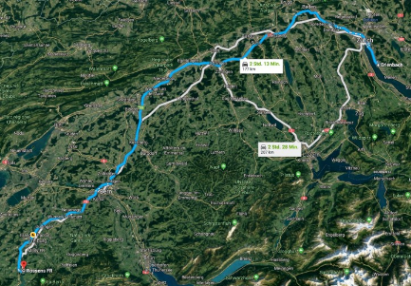
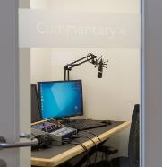
DirectIP – Use case MySports Switzerland
Playout center near Zürich with remote-connection to TV-Studio in Rossens for French program
  Distance between the two sites approximately 200km
100 Gigabit
Redundant single mode fiber
UPC Data Highway
Studio Rossens
for French program
Studio Zürich
for German and Italian program

Slide 40
DirectIP - Overview of the bandwidth requirements
Bandwidth requirements depend on the operational mode
  Transmission through 10G SFP+ modules (Single Mode) in IP switches
  Plus in addition for Audio, I-comm, C2IP, Private date, etc. = about 8Mb
Example: 5x camera running in 1080i fit into 10Gb bandwidth

Slide 41
DirectIP - Overview of the bandwidth requirements
Bandwidth requirements depend on the operational mode
  Transmission through 10G SFP+ modules (Single Mode) in IP switches
  Plus in addition for Audio, I-comm, C2IP, Private date, etc. = about 8Mb
Example: 5x camera running in 1080i fit into 10Gb bandwidth

Slide 42
DirectIP – What the Direct IP solution can do for you
DirectIP…
…add flexibility
…enables improved workflows
…support dynamic infrastructures
…delivers fully future proof solutions
DirectIP help to better cope with the challenges in live broadcast applications
Notes:
But what if you could leverage the strengths of data centers …

Slide 43
Direct IP⁺ - Remote production over IP networks

Slide 44
From DirectIP to DirectIP⁺
All applications where high performance IP infrastructures are available can benefit from the multiple advantages DirectIP offers.
  Higher flexibility, better utilization of equipment, lower operational cost, etc.
DirectIP is an ideal solution for Studio’s, Sports venues, Universities, etc.
  And any other application where 10G IP fiber infrastructures are available.
… but what if 10Gb bandwidth is not available? ... E.g. only 1Gb?
Is it possible to “compress” the video part only?

Slide 45
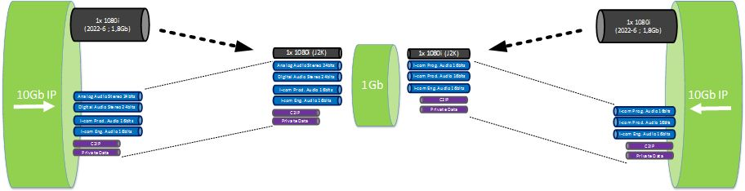
Solution – DirectIP with additional Plus functionality
Compress the video streams, so they fit into smaller bandwidth
Keep IP connection for Audio, I-com, C2IP uncompressed (8Mb trunk)
e.g.

Slide 46
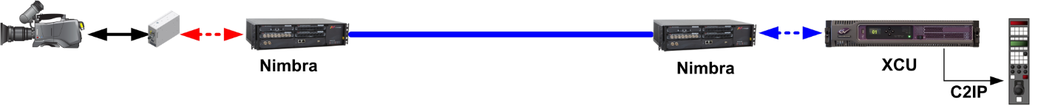
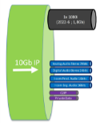
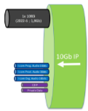


DirectIP⁺ - System overview with Net Insight’s Nimbra
Wide area network
1 Gb/s
Full duplex
Notes:
Service isolation und 93% der auslastung auf dem link
Full stream separation and service isolation end to end
End to end resource allocation to avoid overprovisioning
Traffic shaping and admission control at ingress protect the overall QoS
Full synchronization mechanisms between the different streams
Belgium use case from Cross point at NEP 10G Network
8ms für uncompressed
90 ms für compressed with Direct IP Plus
Wir sehen manchmal auch einen mix der signale
Quality of Service
For professional media services
Service Isolation
For security and predictability
Timing - Sync
PTP and synchonization support
High availability
Too meet strong SLAs
Service Provisioning
Without additional traffic engineering
Monitoring
Per service health monitoring
and SLA compliance
Challenge
Professional media services defines the concept “mission critical”. Customers demands highest possible availability for their services.
Solution
Nimbra MSR has a large palette of availability functions, from fast service re-routing to service specific redundancy, to fit the purpose and wallet. ETS specifically has Hitless 1+1 protection for any streaming service (not only SMPTE 2022) as an option.
ETS Benefits
ETS Hitless 1+1 enables protection for any streaming service against both intermediary loss (burst and random packet loss) as well as complete connection failures. Especially useful together with “smart SFPs” that for instance converts SDI, or even TDM services as E1/E3, to IP/Ethernet. ETS Hitless 1+1 enhances the value of these services.
Kunden besuch
AES-67

Slide 47
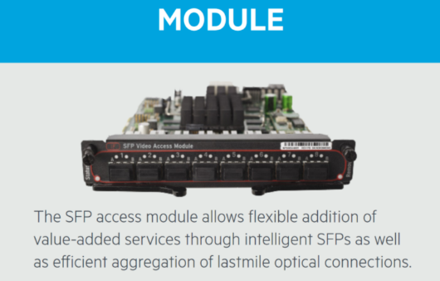
DirectIP⁺ - Specifications with Net Insight’s Nimbra
Net Insight Nimbra SFP Video Access Module J2K
  10 to 250 Mbps for 1080i
  10 to 500 Mbps for 1080p
1080i with J2K @ 160 Mbps…
1080p with J2K @ 320 Mbps…
…seen as visible lossless quality
  Approximately 10x less bandwidth
  required compared to uncompressed
Overall latency - except IP network – approximately 100msec

Slide 48
Remote Production / Possible workflows
3. DirectIP⁺ / DirectIP funtionality over low bandwidth IP networks
+ Full flexibility
+ Adjustable bandwidth requirements
+ Best utilization of equipment
+ Transport over any underlying infrastructure
- Dedicated network multiplexing
equipment required

Slide 49
Summary Remote production over IP networks

Slide 50
Remote Production - Possible workflows
Traditional remote productions
+ Full flexibility
+ Adjustable bandwidth requirements
- IP gateway or dedicated network
multiplexing equipment required
- Difficult to set-up and maintain
2. DirectIP
+ Highest performance
+ Max. flexibility / utilization of equipment
+ Only COTS hardware required
+ Easy to set-up and maintain
- High performance IP network required
- Typically limited to campus installations
3. DirectIP⁺
+ Full flexibility
+ Adjustable bandwidth requirements
+ Best utilization of equipment
+ Transport over any underlying infrastructure
- Dedicated network multiplexing
equipment required

